Slide 1

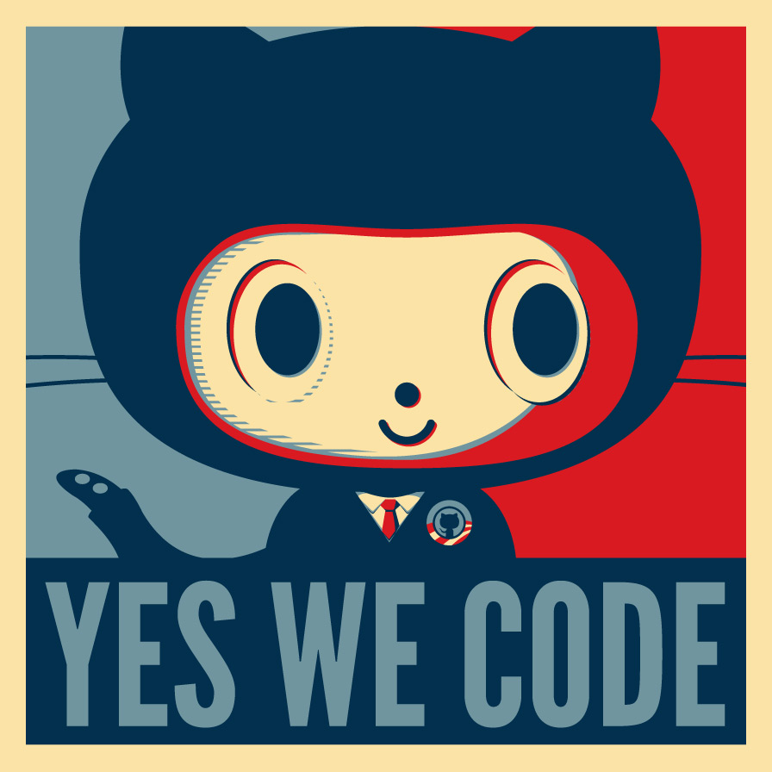

CONVERSATIONS-AS-A-PLATFORM
Bots Are The New Apps
Eng Soon Cheah
www.botframework.com
@CheahEngSoon

Slide 2
Azure Pass Activation
https://www.microsoftazurepass.com/

Slide 3
Who am I ?
Microsoft MVP | Trainer | Speaker
MCSA : Cloud Platform
MCSE : Cloud Platform and Infrastructure
Co-Organizer of Malaysia Mobile .Net Developers Group
Email : cheahengsoon@live.com.my

Slide 4
Why are we hearing so much
about bots now?
AI
Data
Messaging apps
@liliankasem
Notes:
Why are we hearing so much about them now?
Few reasons:
Improvements in AI and NLP – ability to process language, to converse with humans, to understand the world, availability of complex ML algorithms via simple interfaces
Increasing quantities of data, capture from numerous devices, complexity of data and need to extract information quickly, identify patterns efficiently. To enable user to seamlessly connect with this data
Rise of messaging app usage globally.
Significant increase globally in use of messaging apps.

Slide 5



Total Number
of Mobile
Apps
3.6 Million Apps
Notes:
Why bots?
Lot of apps out there – when people say mobile, web -> apps
Many apps out there

Slide 6















Mobile Minutes Spent in for leading OTT messaging apps (US)
Monthly Mobile Usage Source AppAnnie 2015
1
6
2
7
3
8
4
9
5
10
Notes:
Top 10 apps people using on phones
6 are messaging apps

Slide 7


1bn
Total
Registered
Users
(Mobile & Desktop)
800m
300m
100m
62m

Slide 8
Notes:
an alternative to finding simple information on a website eg ‘what’s your postcode?’ – means I don’t have to navigate a website, but use my messaging platform of choice to ask a bot for a postcode
Because people already use these platforms, a bot that operates on them can be faster and easier to use than finding and downloading a new app or navigating a new website.

Slide 9
People
Conversations as a Platform
Bots
Digital assistants
Notes:
This new platform includes a personal digital assistant knows you, knows about your world and is always with you across all your devices helping you with your everyday tasks. And bots, with the capability to take the power of human conversations, and apply it to everything.
We imagine a rich ecosystem of conversations, ones that include: people to people, people to your personal digital assistant, people to bots, and even personal digital assistants calling on bots on your behalf. That's the world that you're going to get to see in the years to come.

Slide 10
People
Conversations as a Platform
Bots
Digital assistants
Notes:
Human language is the new UI
Think of bots as new applications that you converse with. Instead of looking through multiple apps, or pages and pages of websites, you can call on any application as a bot within this conversational canvas.
Bots are the new ‘apps,’ and digital assistants are meta apps or like the new browsers. In this way, intelligence is infused into all of your interactions.

Slide 11
A bot is an application
that performs one or
more automated tasks
SOLVES A PROBLEM
RUNS ANYWHERE,
ANY DEVICE
Notes:
A bot is software that is designed to automate the kinds of tasks you would usually do on your own,
They sit in front of processes/tasks – reservations, scheduling dinner, FAQ, pro-active info, an assistant for a particular task.
The increasingly common form of bots, chatbots. They have their own UI (human language). Rather than being hidden behind process and applications, users can start to have conversations with bots directly

Slide 12
How do you make a bot?
How do you make a bot GREAT?

Slide 13
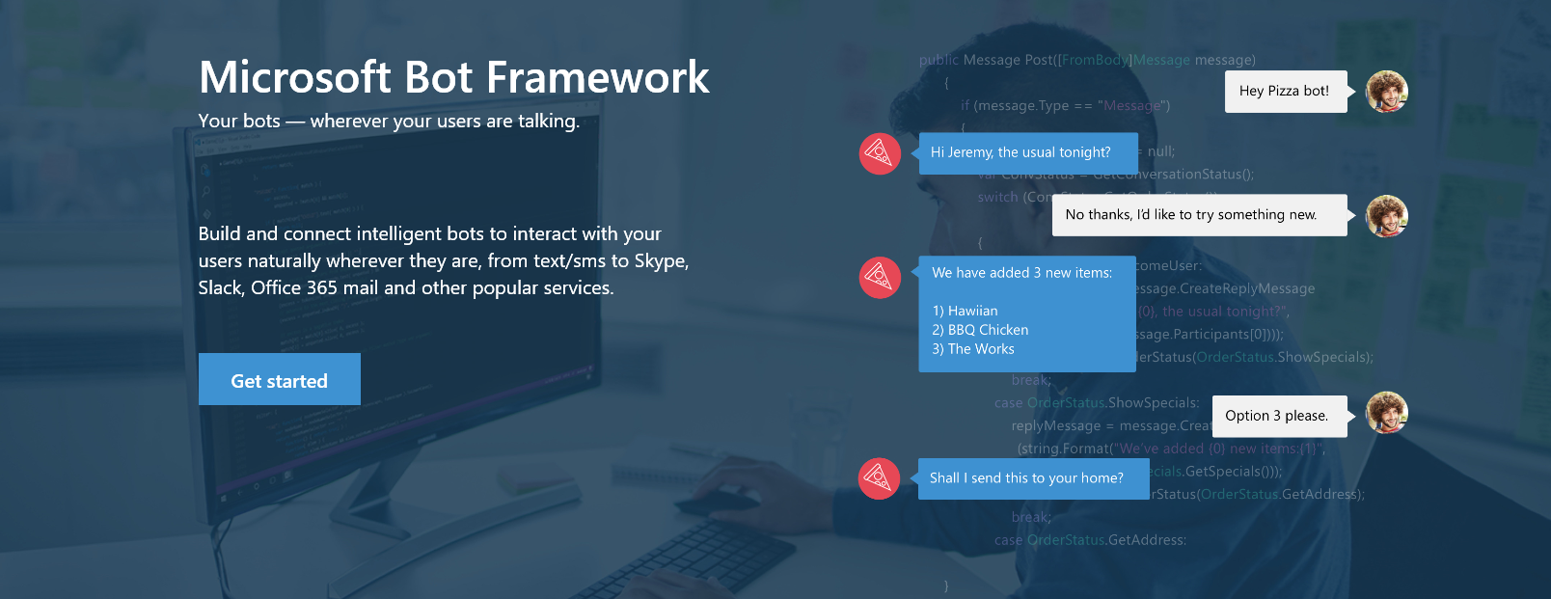
www.botframework.com

Slide 14
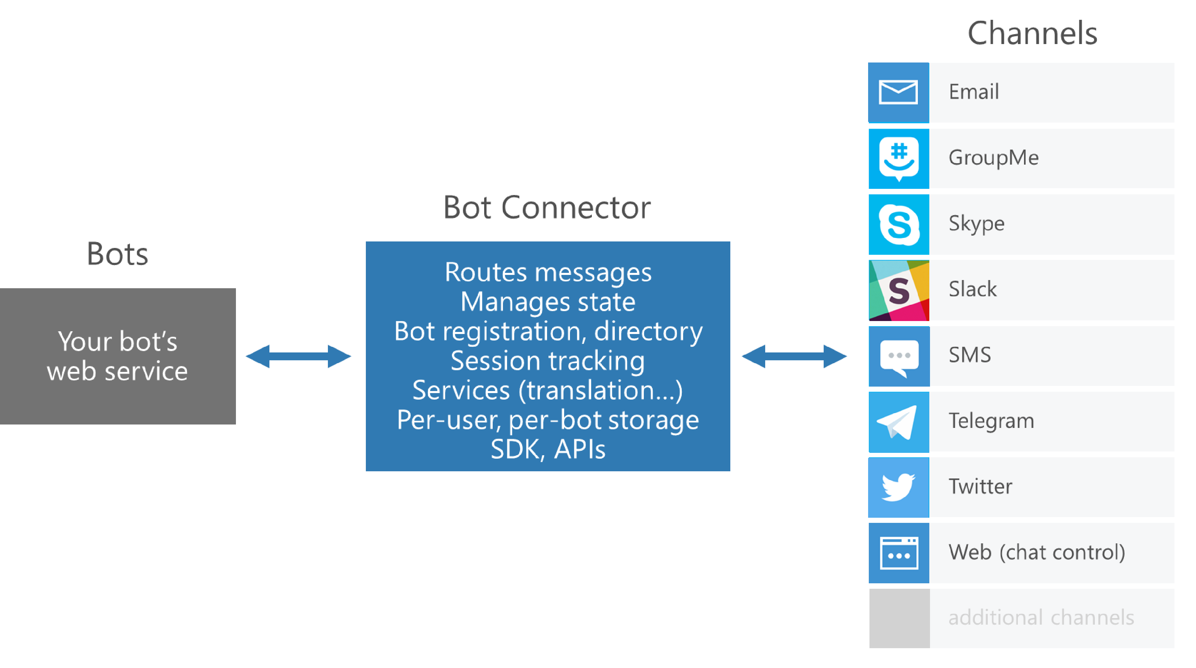
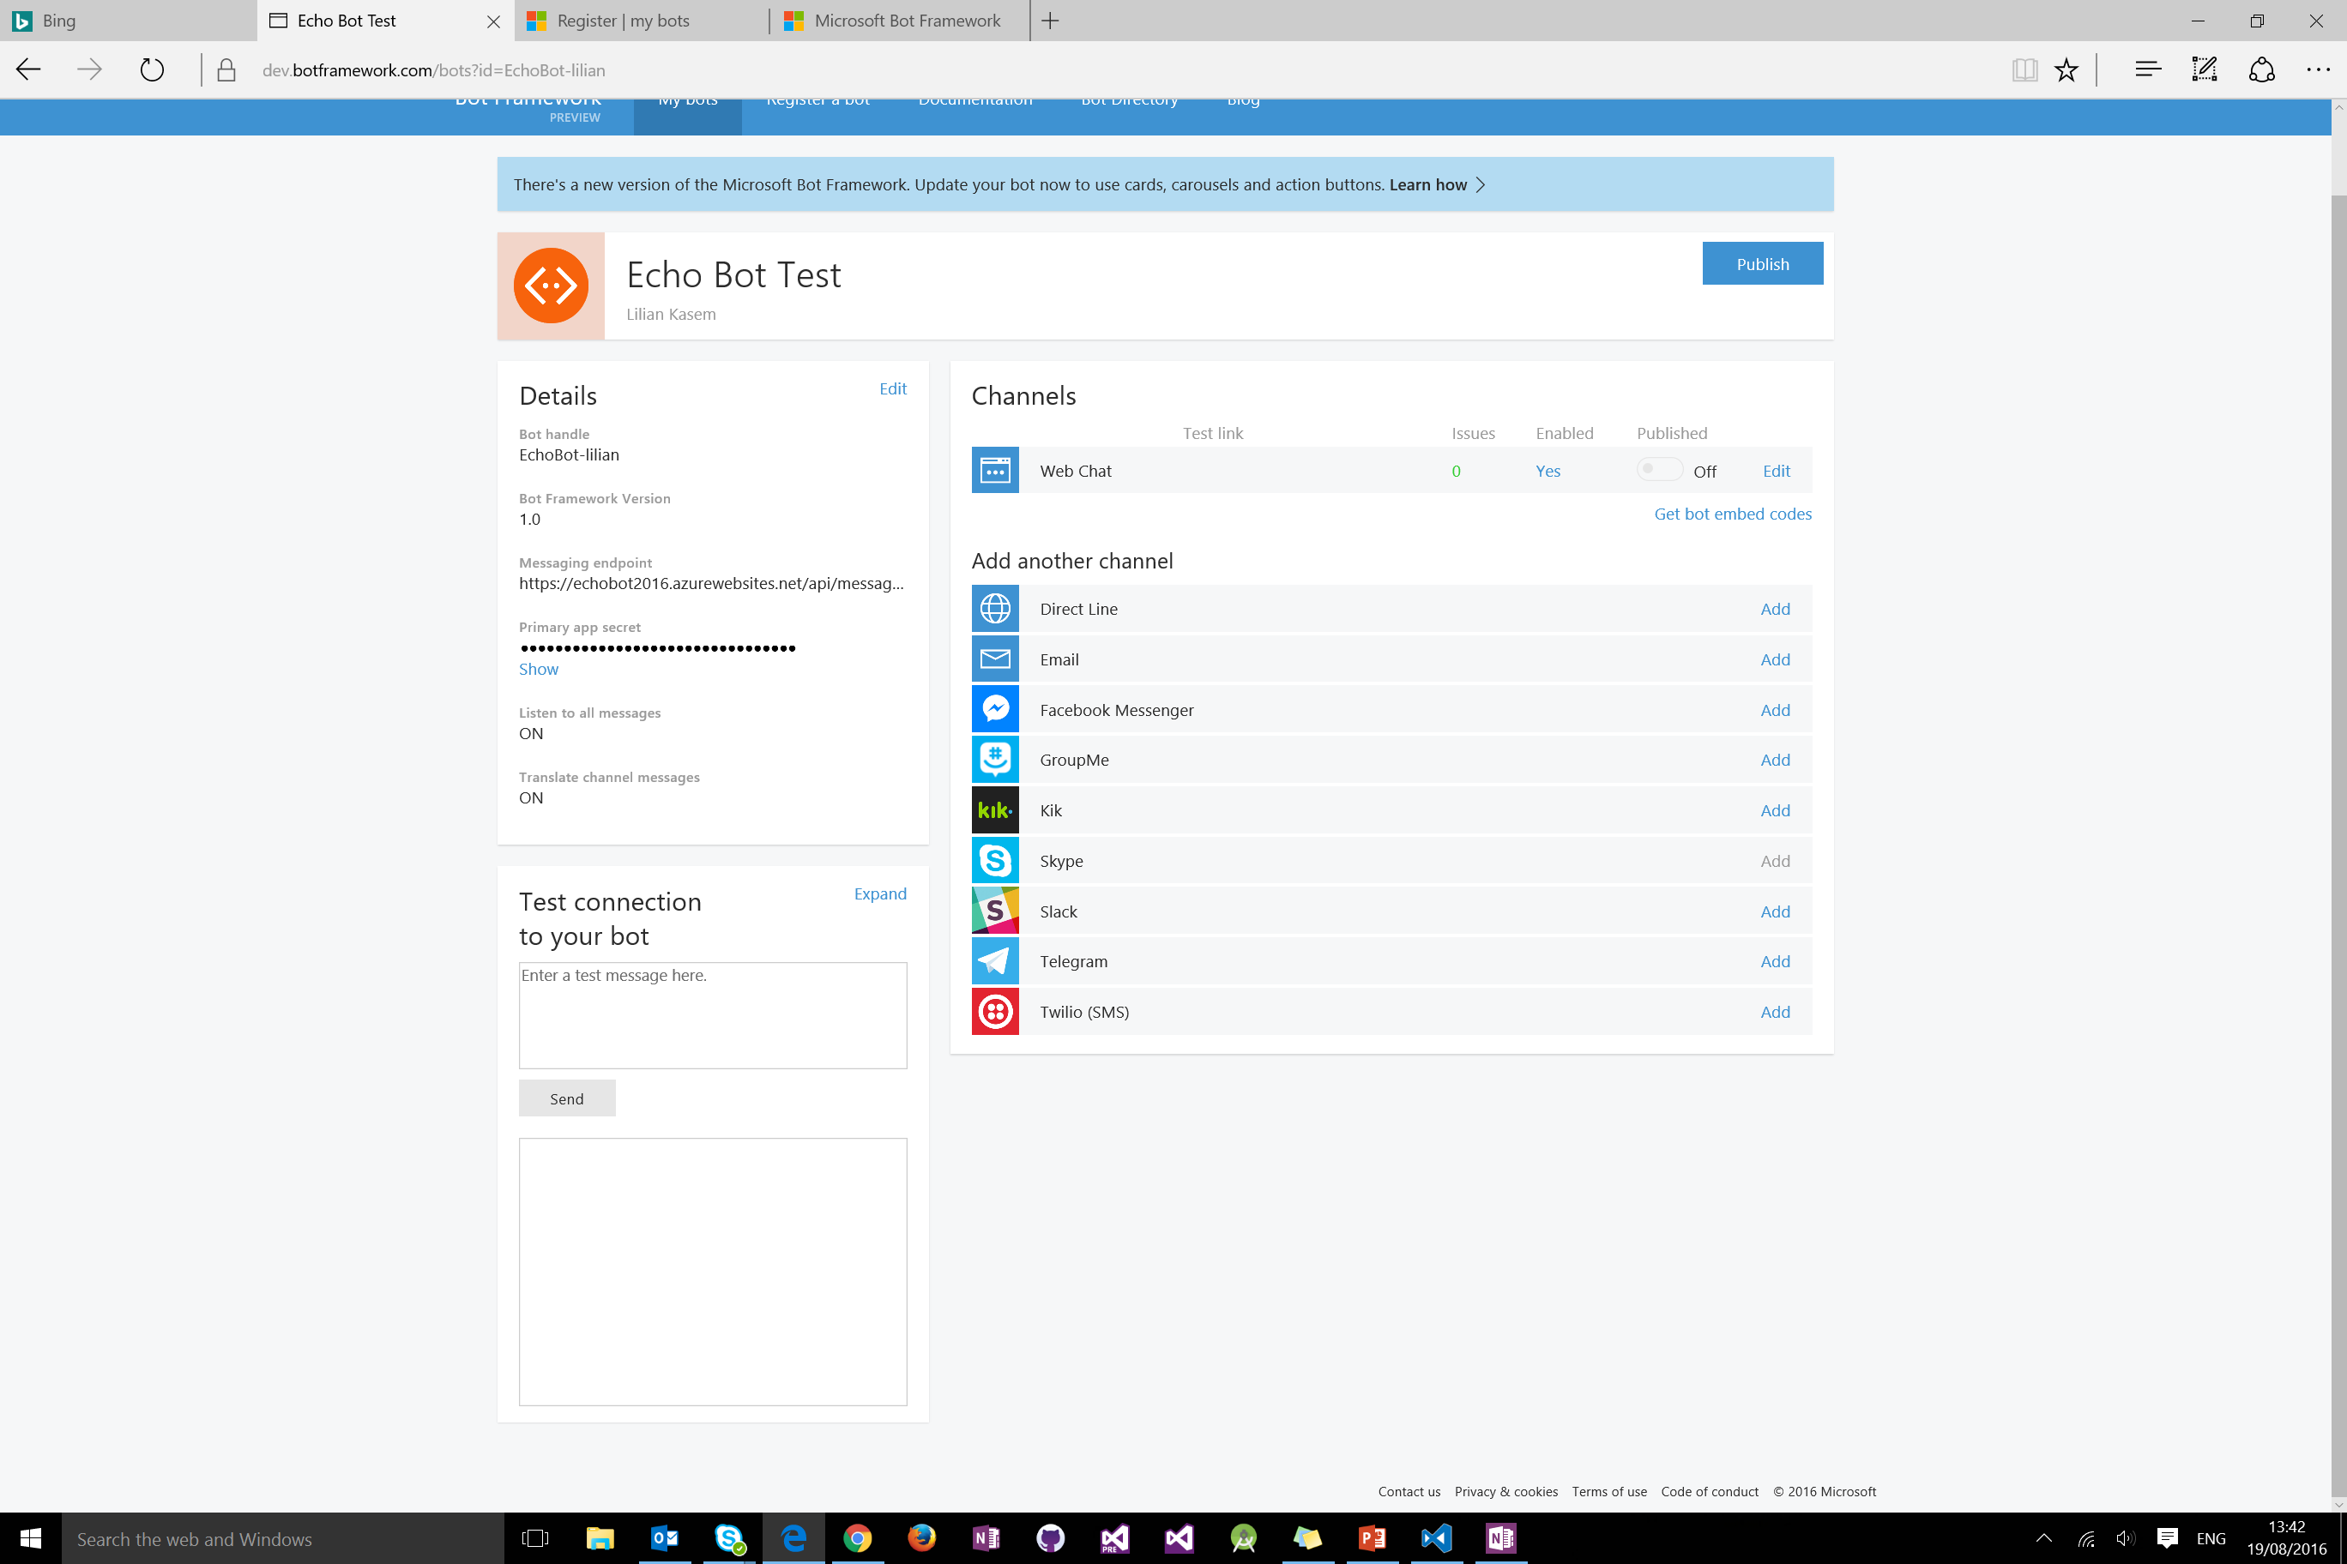
Bot Connector Basics

Slide 15

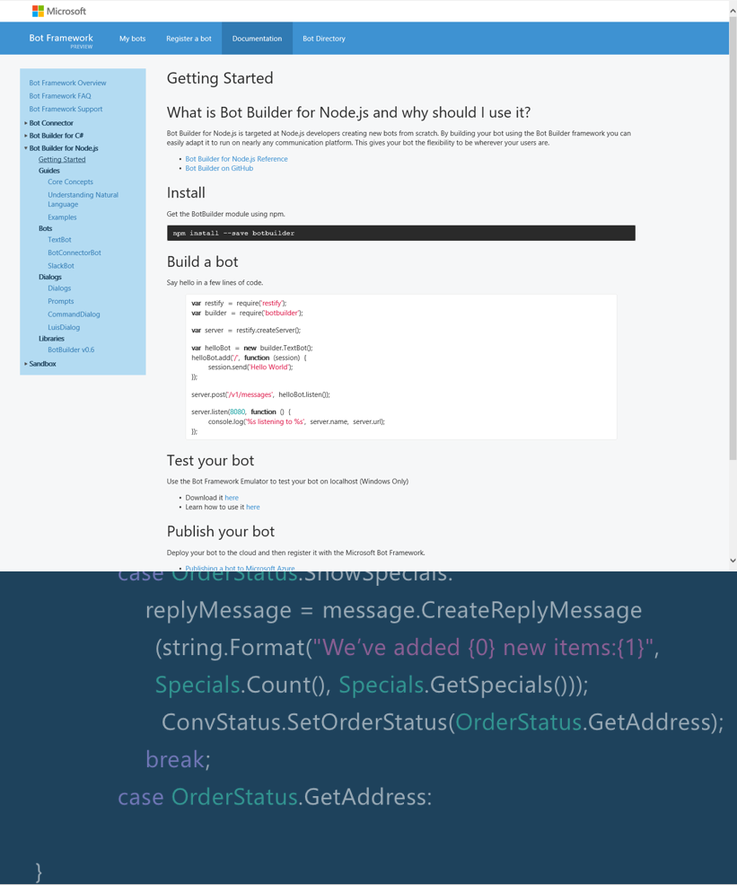
Bot Builder SDK
C# and Node.js
Dialogs
Built-in prompts
Natural language understanding (LUIS)
Form slot filling
Profile (e.g., home address)
Notes:
Dialogs are reusable
Conversations are scalable to multiple machines
Dialog state is persisted in Bot Connector (per-user, per-session, per- user+session)
Built-in prompts
Yes/No, String, Number, Choices

Slide 16
Bot Connector Messages
Your
Bot
Bot Connector
{
"type": "Message",
"id": "68YrxgtB53Y",
"conversationId": "DphPaFQrDuZDKyCez4AFGcT4vy5aQDje1lLGIjB8v18MFtb",
"language": "en",
"text": "You can say \"/order\" to order!",
"attachments": [ ],
"from": {
"name": "+12065551212",
"channelId": "sms",
"address": "+12065551212",
"id": "Ro52hKN287",
"isBot": false
},
"channelData": { SMS data here },
"botUserData": { your data here },
...
}

Slide 17
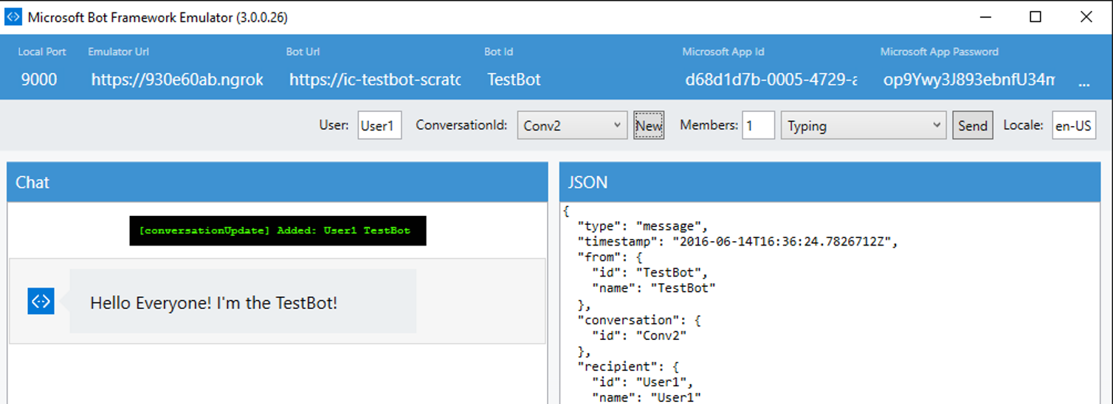
Bot Framework Emulator
Send requests and receive responses to/from your bot endpoint on localhost
Inspect the JSON response
Emulate a specific user and/or conversation

Slide 18
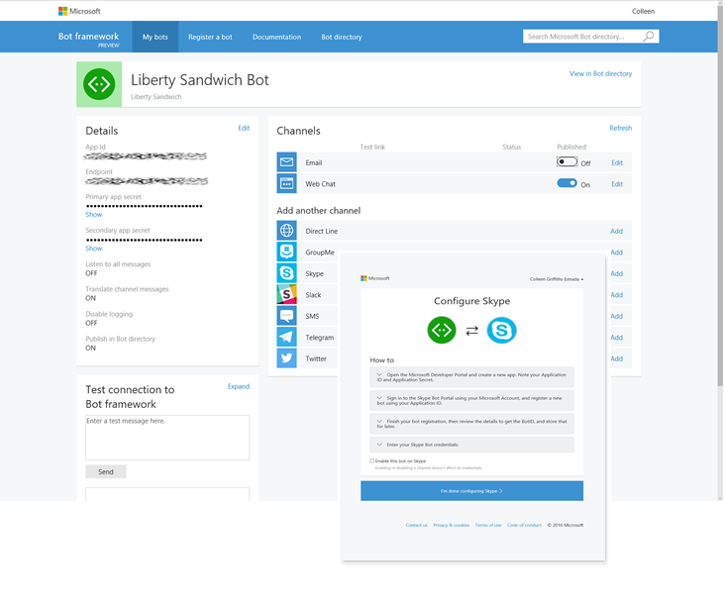
Developer Portal
Register
Configure Channels
Test
Manage

Slide 19
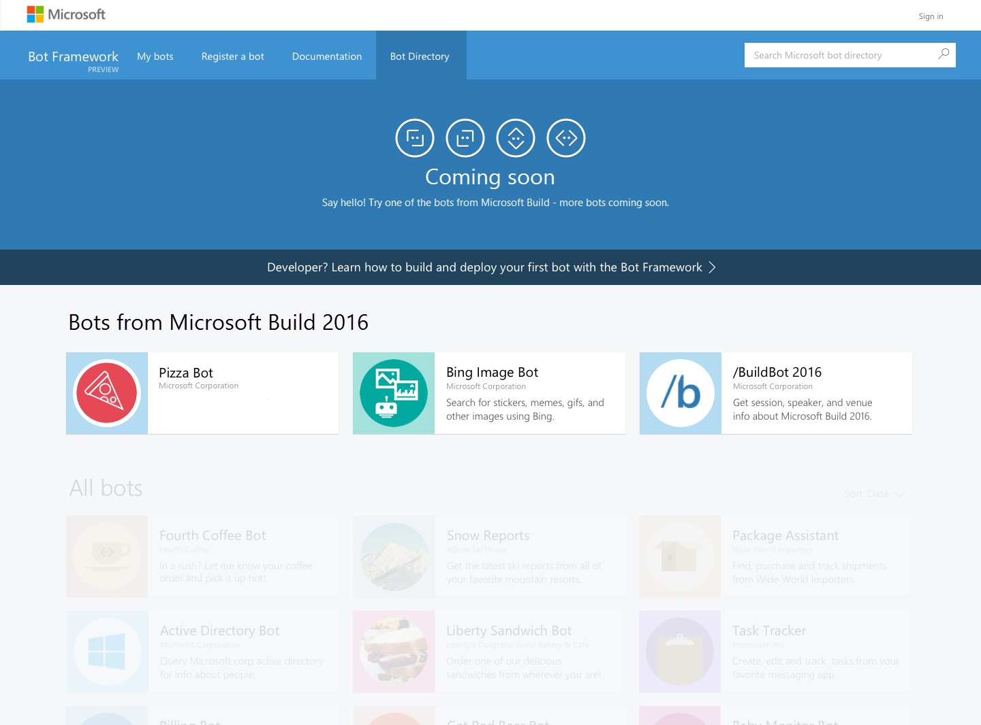
Bot Directory
Notes:
Public Directory of Bot Framework Bots

Slide 20
Demo
Hello World

Slide 21
Adding
Bot Smarts
COGNITIVE APIs
Notes:
Now that you built your bot, it’s time to add smarts to it and make it more useful and engaging for your users. An intelligent bot has human-like senses and skills. It is able to understand what we are saying or writing in natural language and respond back, see our world as we see it, discover information and extract knowledge from different sources to provide useful answers, and more importantly learn as it acquires more experience to continuously improve its capabilities. Sounds daunting, but we are here to help you add some of these cognitive skills to your bot.

Slide 22
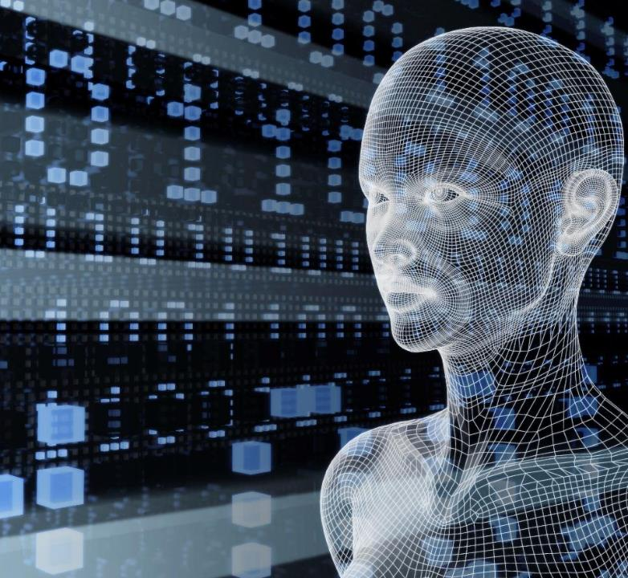
Vision
From faces to feelings, allow your apps to understand images and video
Microsoft Cognitive Services
Give your apps a human side
Speech
Hear and speak to your users by filtering noise, identifying speakers, and understanding intent
Language
Process text and learn how to recognize what users want
Knowledge
Tap into rich knowledge amassed from the web, academia, or your own data
Search
Access billions of web pages, images, videos, and news with the power of Bing APIs
Notes:
20 different apis availble
Microsoft Cognitive Services lets you tap into an ever-growing collection of powerful AI algorithms developed by experts in the fields of computer vision, speech, natural language processing, knowledge extraction and web search. They simplify a variety of AI-based tasks, giving you a quick way to add state-of-the-art intelligence technologies to your apps with just a few lines of code. The APIs integrate into whatever language you prefer, on your platform of choice. The APIs are also constantly improving, learning, and getting smarter, so experiences are always up to date. Simply drop the API call into your bot’s code and you are set.
What are Cognitive Services? Microsoft Cognitive Services are a new collection of intelligence and knowledge APIs that enable developers to ultimately build smarter apps.
NOTES: key concepts we are trying to convey in this above statement:
That we are bringing together Intelligence (Oxford) and Knowledge from the corpus of the web (Bing)
That cognitive = human perception and understanding, enabling your apps to see the world around them, to hear and talk back with the users—to have a human side.
What are Microsoft Cognitive Services?
Microsoft Cognitive Services is a new collection of intelligent APIs that allow systems to see, hear, speak, understand and interpret our needs using natural methods of communication. Developers can use these APIs to make their applications more intelligent, engaging and discoverable. To try Cognitive Services for free, visit www.microsoft.com/cognitive.
With Cognitive Services, developers can easily add intelligent features – such as emotion and sentiment detection, vision and speech recognition, knowledge, search and language understanding – into their applications. The collection will continuously improve, adding new APIs and updating existing ones.
Cognitive Services includes:
Vision: From faces to feelings, allow apps to understand images and video
Speech: Hear and speak to users by filtering noise, identifying speakers, and understanding intent
Language: Process text and learn how to recognize what users want
Knowledge: Tap into rich knowledge amassed from the web, academia, or your own data
Search: Access billions of web pages, images, videos, and news with the power of Bing APIs

Slide 23
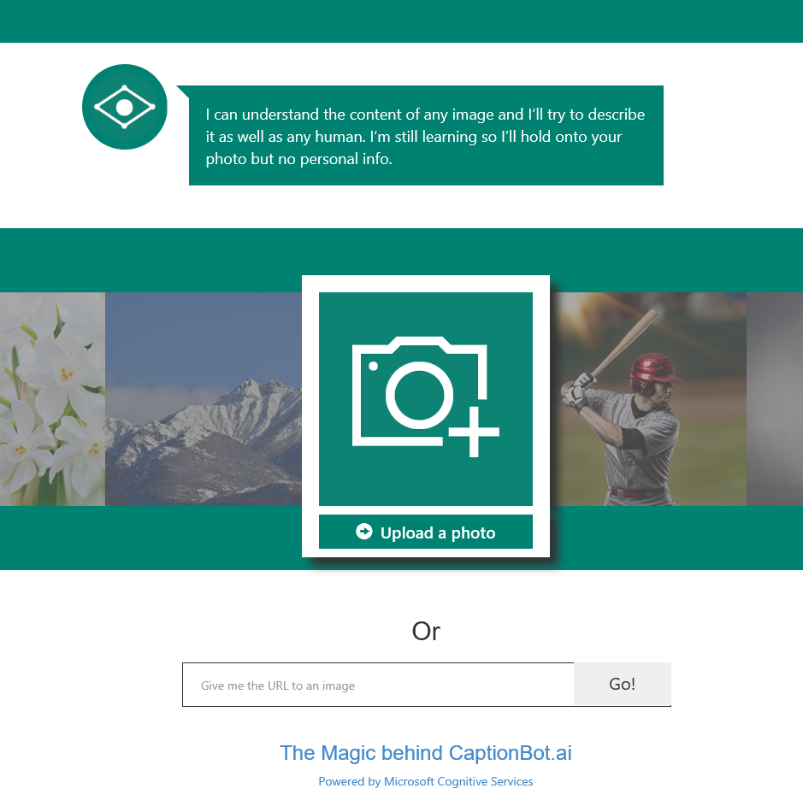
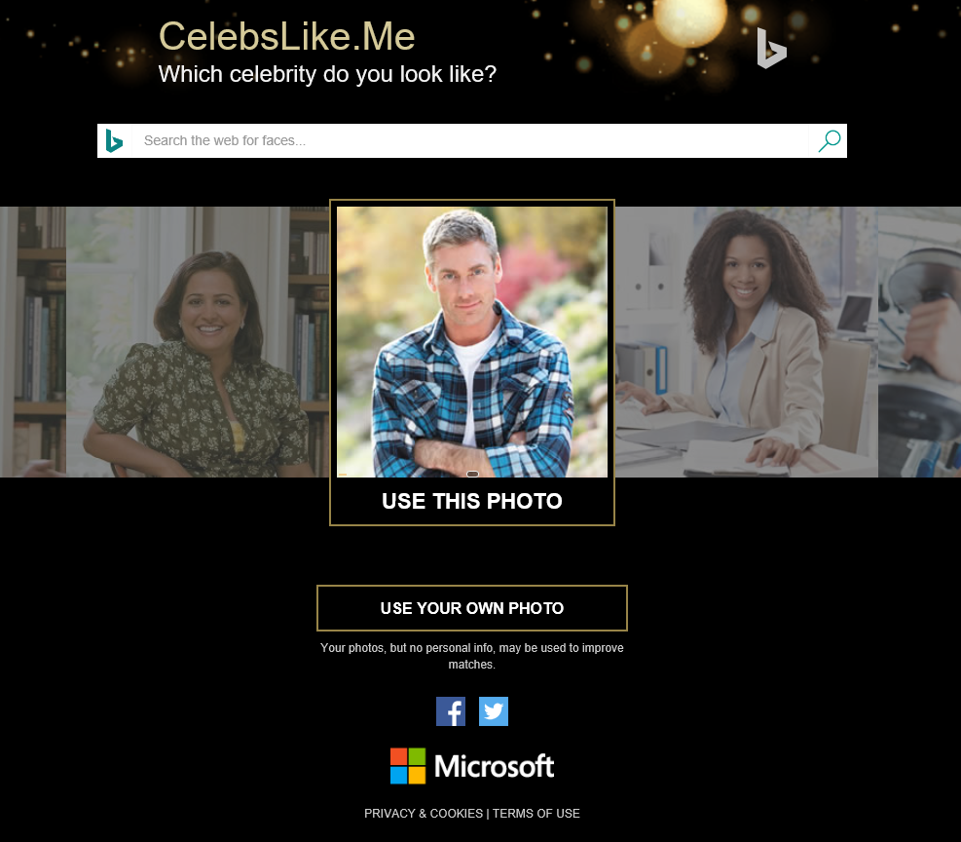
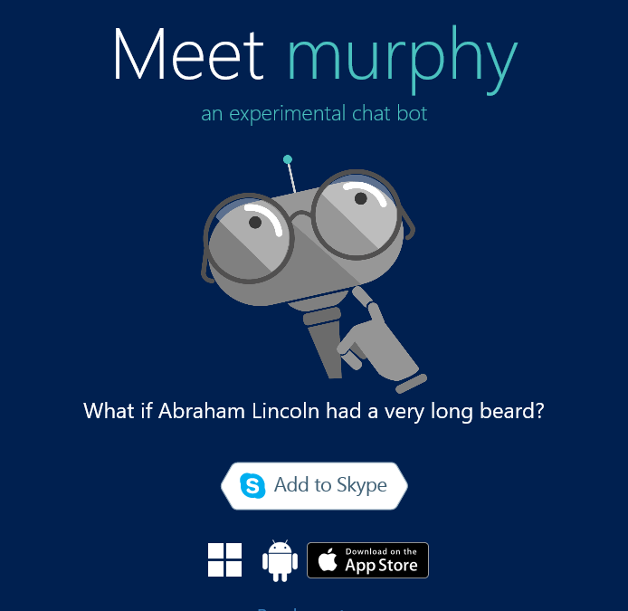
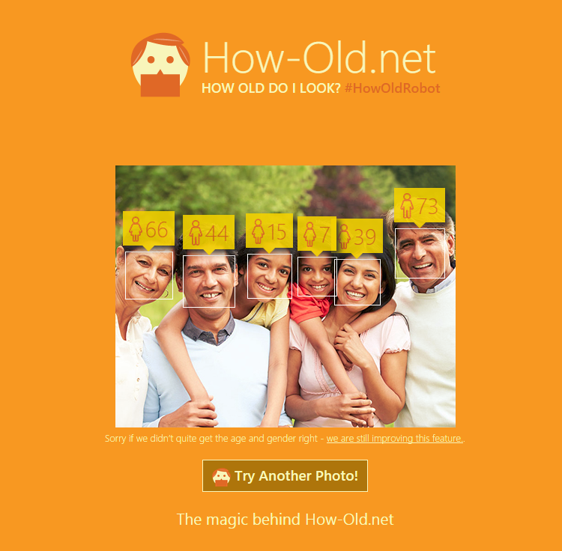
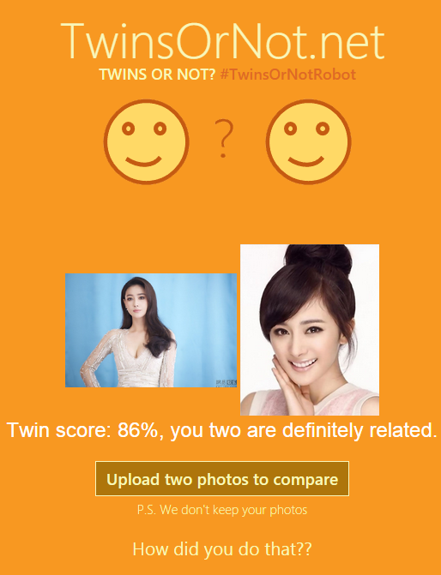
Apps Powered by MS Cognitive Services
Captionbot.ai
CelebsLike.Me
Murphybot.com
How-Old.net
TwinsOrNot.net
https://www.microsoft.com/cognitive-services/en-us/applications
Notes:
Examples demos you can check out online showing off some of the cognitive services

Slide 24
Speech & Language
Custom Recognition | Speaker Recognition | Speech
Bing Spell Check | Language Understanding | Linguistic Analysis | Text Analytics | Web Language Model
Notes:
In an application where the main UI is human language, these APIs can be a huge help, and can be the difference between a bot and a GREAT bot
Understanding users intent and extracting entities
Understanding the sentiment of a conversation
Speaking to users regardless of their language

Slide 25
Demo
http://github.com//busbhttps://github.com/MSFTImagine/computerscience/tree/master/Tech%20Talks/BusBot
Notes:
LUIS model for Bus Bot
Code for Bus Bot showing intent dialogs
Demo on telegram and facebook and skype

Slide 26
Bot + Cognitive Services
Sample use cases:
Computer vision API : human readable captions
Speech APIs: authentication
LUIS API: intent
Knowledge APIs: product recommendation
Autosuggest API: ease query input
Linguistic API: sentiment
Notes:
Computer vision API to create human readable captions for the content of an image uploaded to a bot
Like CaptionBot.ai – a bot that reports back in human way the contents of an image
2. A bot to authenticate users using a voiceprint by leveraging the Speech APIs
Authentication as a user speaks to the bot with a speaker verification profile or “voiceprint”
Using the LUIS (Language Understanding Intelligent Service) API, a bot can recognize the intent of a user
LUIS analysis for queries such as “What is the weather in Toyko today?” using entities to parse out intent (what the user is asking for)
4. Knowledge APIs can give a bot the ability to recommend products frequently bought together based on our knowledge and/or a user’s history
Also, Knowledge could search through a graph database to return relevant academic papers from a natural language query
5. The Autosuggest API from Search can ease the burden of typing queries to a web search bot
Search also has other capabilities such as returning the latest trending news on a topic for example

Slide 27
Bot Best Practices

Slide 28
It’s not just a dev’s job
Notes:
As big a part of building a Bot is the tone of voice / personality that it uses – don’t think that this is just a dev’s job – in the same way that we’ve always needed visual designers and UX designers Bots will require a new type of role depending on their complexity – business analysis and business logic & copywriting are a massive part of the Bot build process

Slide 29
Best Practices: Planning
How does it add value?
What is its task?
How will people use it?
Notes:
Planning: Understanding why your bot exists
How does it add value? As with a website or mobile app, a bot needs to serve a purpose to get people to use it. This means that it should be useful (like Expedia’s travel bot), educational (like Tina the Tyrannosaurus rex chatbot), or entertaining (like ButterBot).
What is its task? A bot should perform one or two core tasks. The more focused the bot, the easier it is to anticipate a user’s interactions with it, which is key to building artificial intelligence (A.I.) that makes the bot intuitive.
How will people use it? Once the bot has a focus, spend time mapping out all expected interactions that users could have with it so that it can respond accordingly.
Before building a bot, it’s important to understand why the recent trend exists. Research shows that people use just five apps on their phone, the most popular of which are messaging apps. Because people already use these platforms, a bot that operates on them can be faster and easier to use than finding and downloading a new app or navigating a new website. With that in mind, ask these questions in the early planning stages of a bot:

Slide 30
Best Practices: Planning
How does it add value?
What is its task?
How will people use it?
Notes:
If answer is no, don’t make a bot!

Slide 31
Best Practices: Onboarding
Have the bot introduce itself
Explain what it can do
Introduce a menu that users can easily return to if stuck
Suggest a first action for the user to take
Notes:
Onboarding: Getting users comfortable with the bot
Because bots are still relatively new, users need a brief onboarding in their first interactions with the bot to understand how to use it. In the first message(s), you should:
Have the bot introduce itself
Explain what it can do
Introduce a menu that users can easily return to if they feel stuck (say, by typing the word “menu”)
Suggest a first action for the user to take

Slide 32
Best Practices: Interaction
Use buttons
Be clear when asking for a user’s information
Layer in A.I.
Add conversation
Don’t leave users hanging
Add some design elements
Notes:
Interaction: Your bot’s user experience
Bots don’t have fancy interfaces, so there is nothing to mask the stench of a lame bot. It must be able to interact by listening to input, providing the correct response, and anticipating a user’s future needs. Here’s how to tackle building out a bot’s interactions:
Use buttons. Remember, the bot should be simple and fast to use. Tapping a button is both easier and faster than typing out a sentence in most cases. Buttons are also more accurate because they don’t rely on the bot having to interpret free text. Use buttons liberally!
Be clear when asking for a user’s information. Of course, buttons don’t make sense for all interactions. When a user needs to give input, have the bot be very clear about what information (and in what format) it is looking for so that it can get the response it needs to perform its task.
Layer in A.I. First and foremost, A.I. should be used to interpret what users want when they chat with the bot. For example, if users are told to get to the bot’s menu by typing “menu,” the bot should be smart enough to also understand that words like main menu, main, features, home, home screen, start, etc. should also take users back to the menu. This kind of intelligence must be built for all expected user inputs to make your bot user friendly.
Add conversation. Now that we are on the topic of A.I., the bot should also have some responses to basic conversation. For example, what will it say if a user asks how its day is going, where it lives, or how it was created?
Don’t leave users hanging. There will be times when the bot doesn’t understand what the user wants. In those instances, it should still be intelligent enough to give a generic response (something like, “I’m sorry, I didn’t catch that.”) or redirect to a service representative who can take over.
Add some design elements. Use graphics, video, and/or emojis where they make sense to provide users with a more branded and visually stimulating experience.

Slide 33
Best Practices: Live
Capture Telemetry
Identify pain points
Implement Feedback loop
DevOps
Notes:
Start with end user and go backwards to solution
Data driven folks should step back and consider time from design to product, including integrations
Keep the focus on user experience: Unless it is low friction enough, adoption doesn’t happen

Slide 34
Are bots the new apps?
Notes:
Yes and No
Bots are going to change the way we interact with brands and services in order to access information just like apps did when they first launched. That doesn’t mean we won’t need apps, just like when apps first came along, we still use websites even today
Bots will make us more productive
An alternative to finding simple information on a website eg ‘what’s your postcode?’ – means I don’t have to navigate a website, but use my messaging platform of choice to ask a bot for a postcode
Some will be easy to build and offer access to simple information
Some will be whimsy, as in, just for fun
Some will be complicated, take months to build and require deep investment over time – in the same way that apps do today –
but, in the same way that websites and apps were one time a very expensive investment, tools and the middleware required to build these are becoming easier to work with and more productive from a dev’s perspective
For developers
Reach the broadest set of users where they are conversing.
Bots are more capable because of supporting services (profile, history, memory, etc.)
Bring your own bot or build your own bot with the Bot Builder SDKs
For end users
Users can choose from a variety of conversation channels
Users have trust and control of their data
For businesses
Broad access to their customers, new experiences
Reduced cost of development
Higher quality bots

Slide 35
Activation of Microsoft Azure Pass

Slide 36
GitHub URL
http://bit.ly/SPAzure

Slide 37
Lab
FAQ Bot

Slide 38
https://www.qnamaker.ai

Slide 39
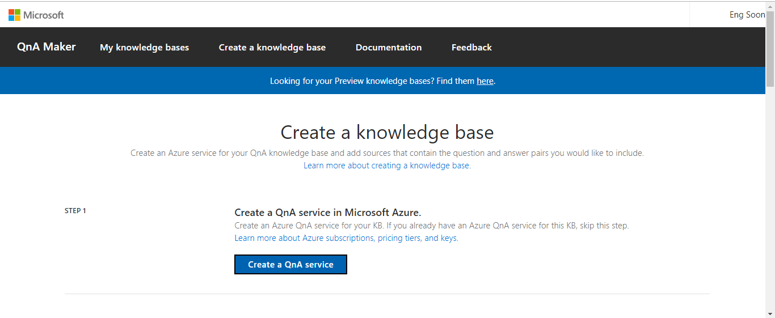

Slide 40
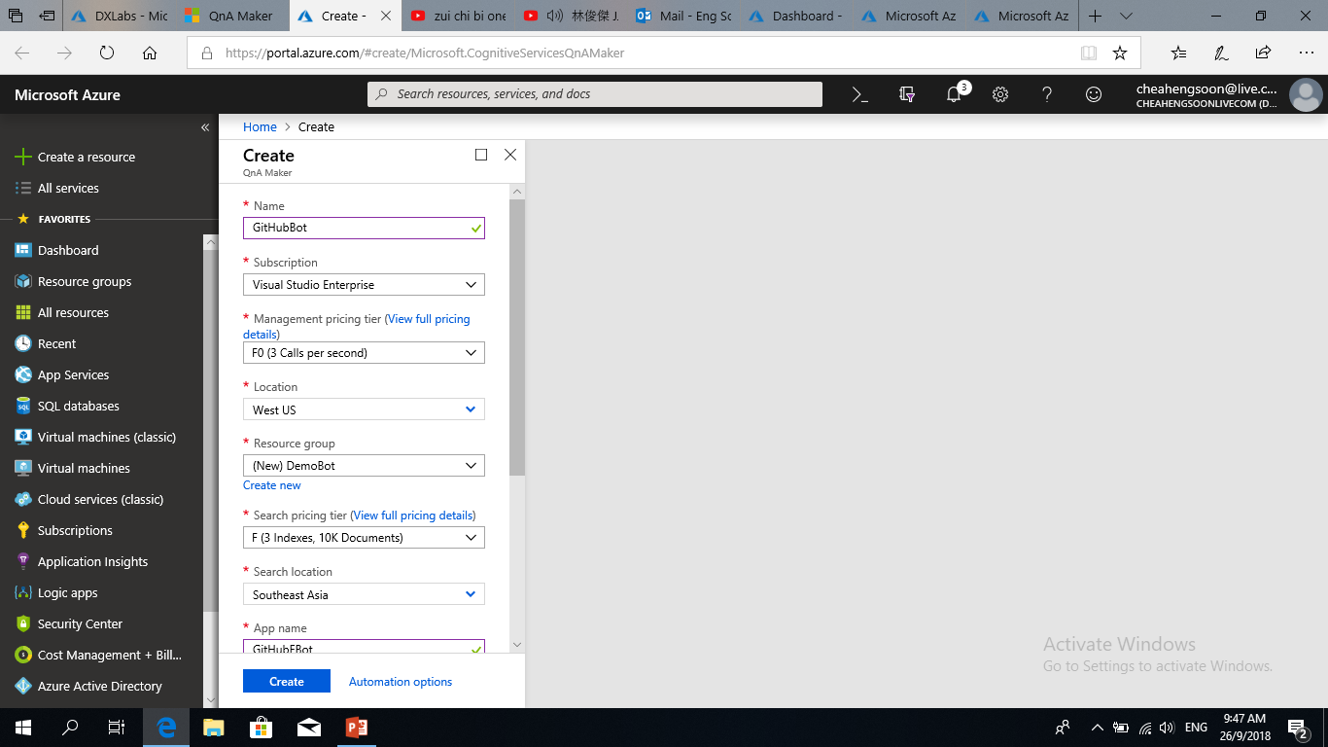

Slide 41
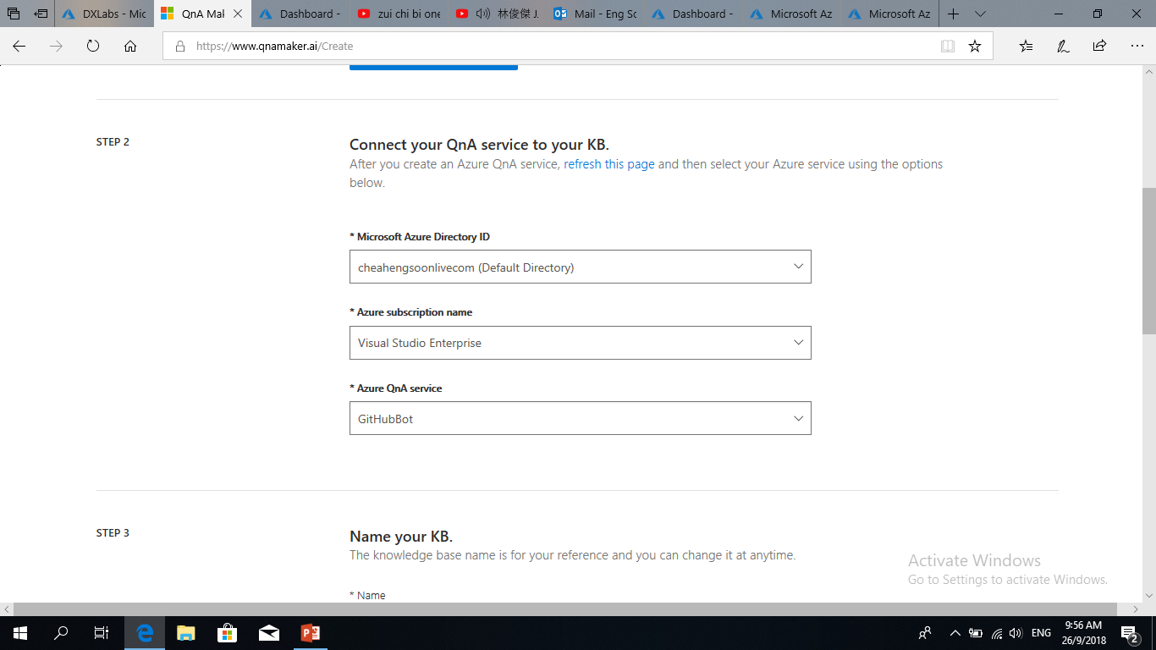

Slide 42
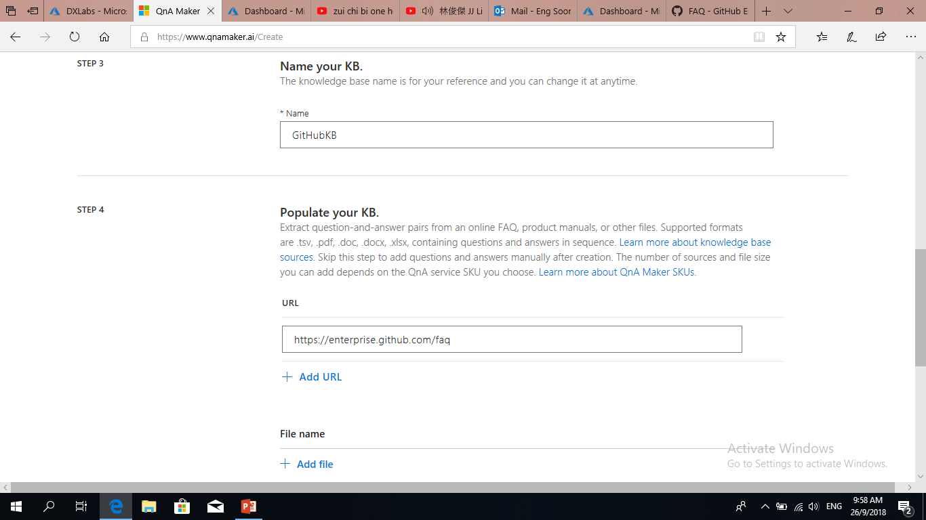

Slide 43
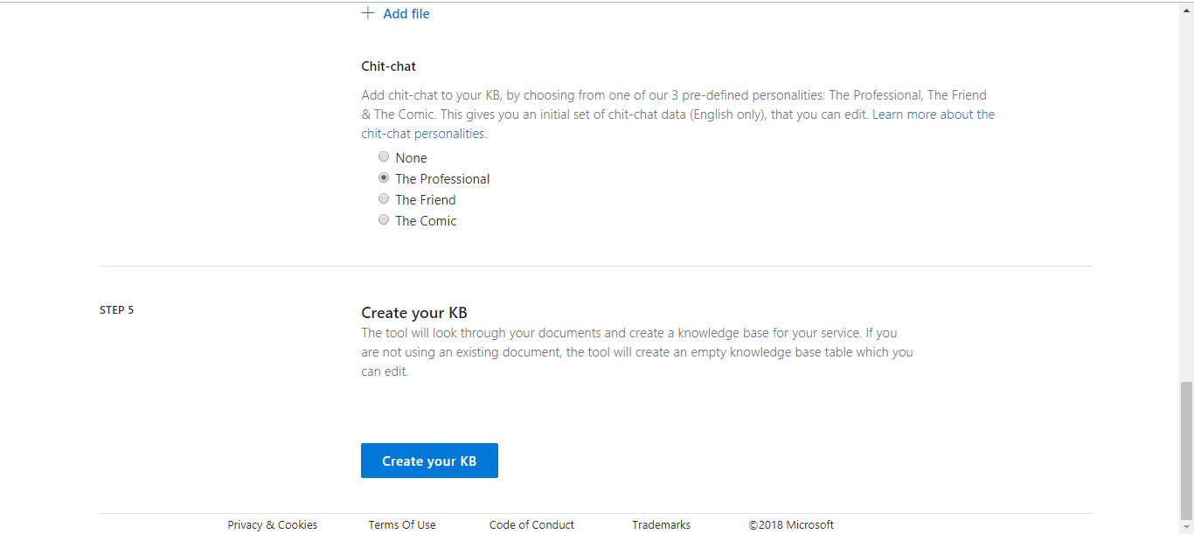

Slide 44
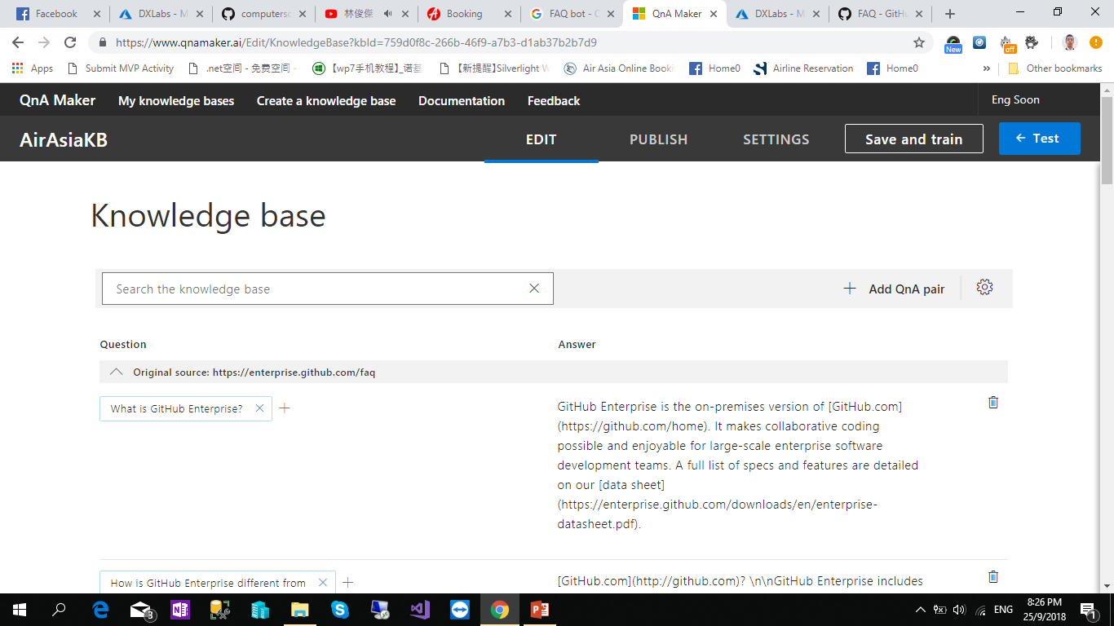

Slide 47
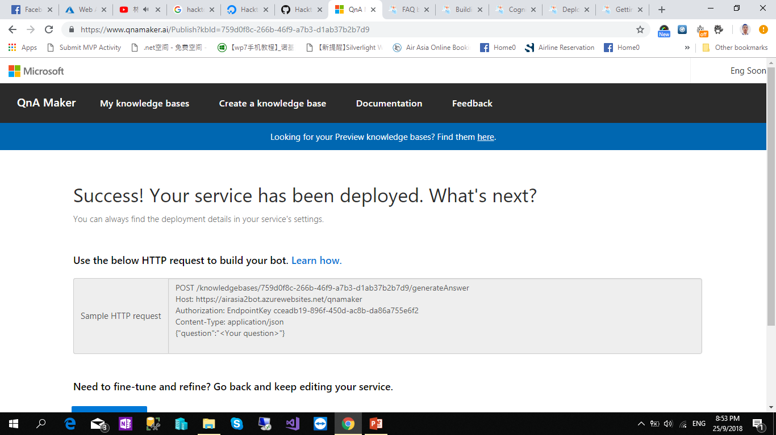

Slide 48
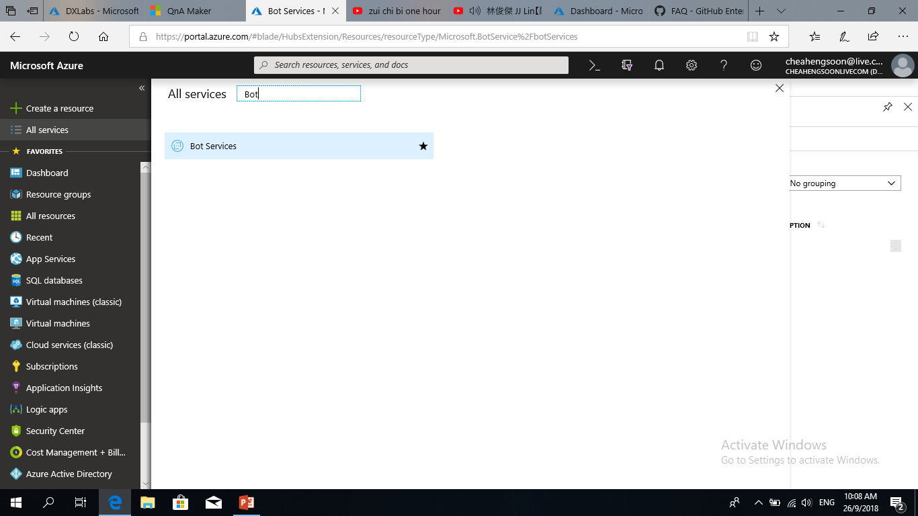

Slide 49
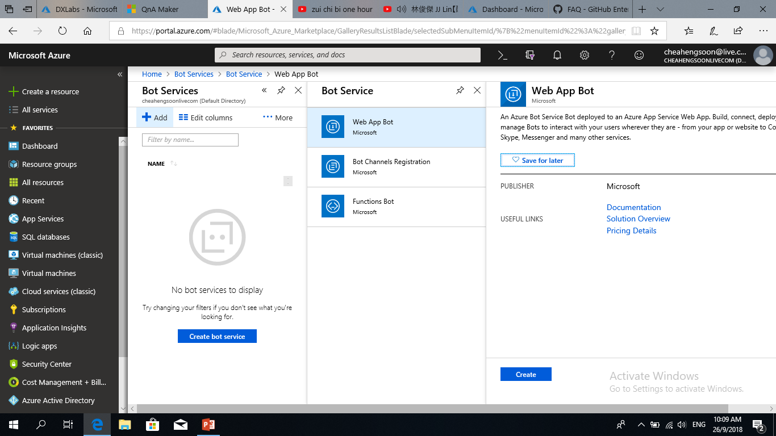

Slide 50
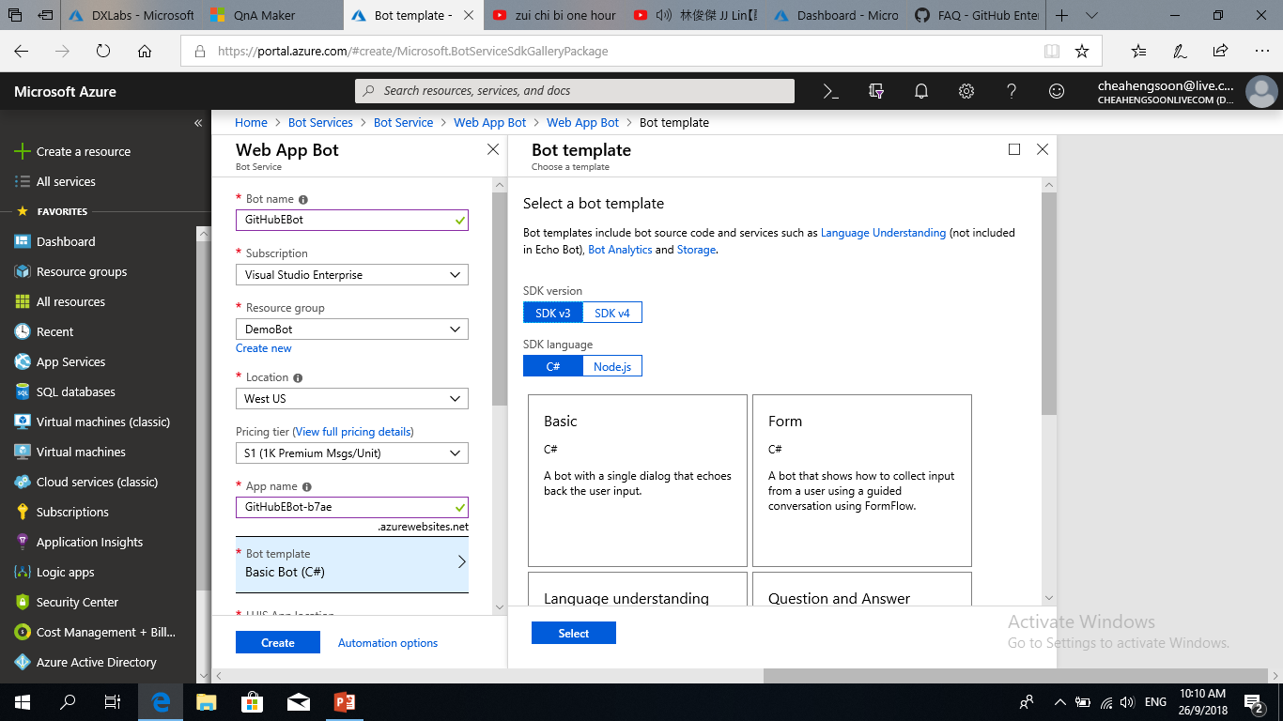

Slide 51
QnAKnowledgebaseId
QnAAuthKey
QnAEndpointHostName

Slide 52
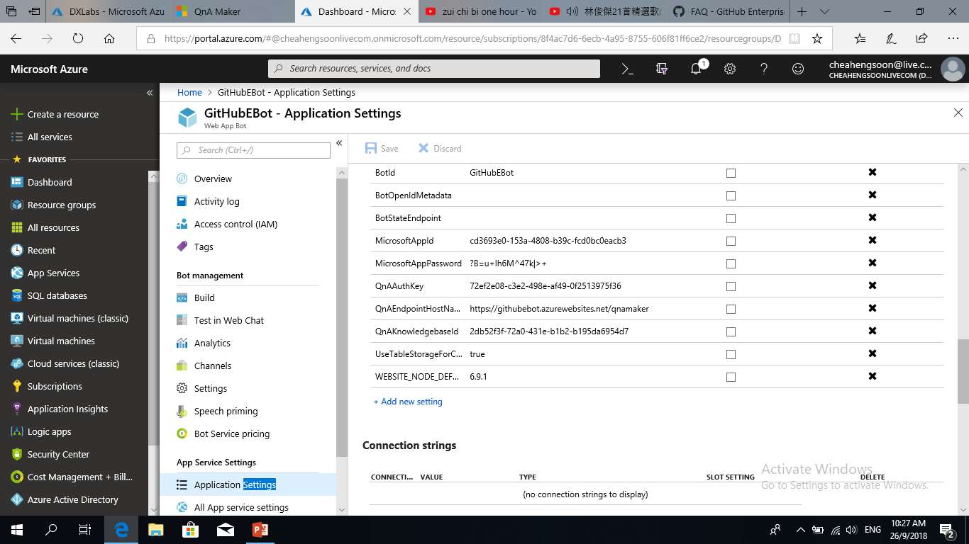

Slide 53
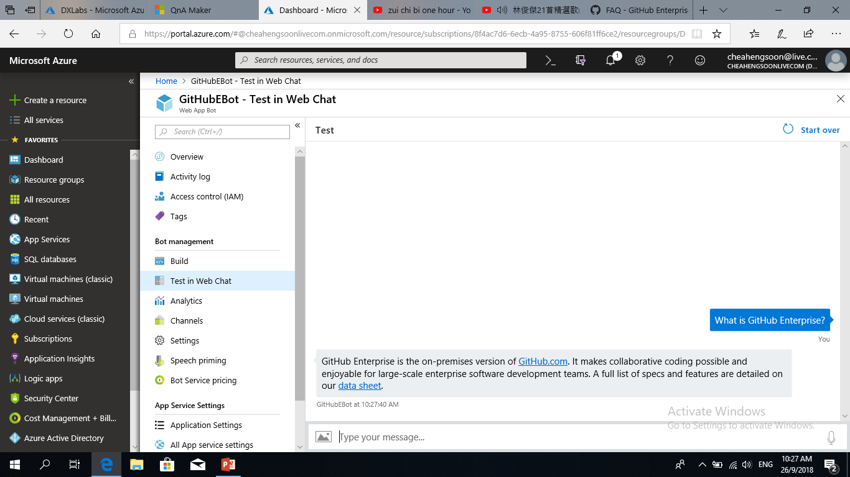

Slide 54
References
Twitter : @CheahEngSoon
YouTube Channel :
http://bit.ly/engsoonyoutube
Email : cheahengsoon@live.com.my
Blogs:
http://www.techconnect.io/

Slide 55
dev.botframework.com
microsoft.com/cognitive-services
http://github.com//busbhttps://github.com/MSFTImagine/computerscience/tree/master/Tech%20Talks/BusBot
www.botframework.com
Twitter

